Slide 1

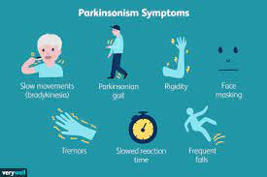
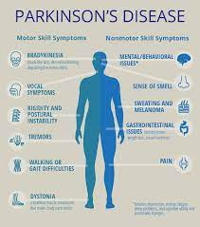
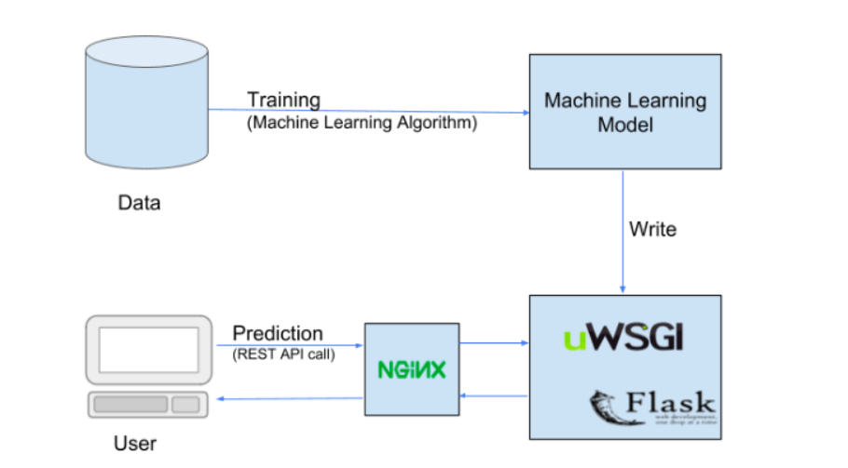
Parkinson’s Disease Detector
Project Group ID:-127
Chirayu Jaiswal, Nayan Agarwal, Pritosh Thomas, Rikin Correya, Devansh Jain
Guide – Dr. Abha Trivedi
INTRODUCTION
RESULTS
DISCUSSION
The project helps us to identify whether a Person is positive for Parkinson’s disease or not by taking in and comparing values of different parameters like ‘Shimmer:APQ3’, ‘RPDE’, ‘MDVP:PPQ’, etc. to the machine learning model. It’s going to be a safe, easy and time saving method that can be used by anyone across the globe to come to a conclusion that is extremely accurate.
A progressive disease of the nervous system marked by tremor, muscular rigidity, and slow, imprecise movement, chiefly affecting middle-aged and elderly people. It is associated with degeneration of the basal ganglia of the brain and a deficiency of the neurotransmitter dopamine.
About The Python Machine Learning Project
In this Python Machine Learning Project, using the Python Libraries Scikit-learn, NumPy, and Pandas, we will build a model using an XGB Classifier. We’ll load the data, get the features and labels, scale the features, then split the dataset, train and build the XGB Classifier model, and then finally also test it and calculate the accuracy of our model in detecting Parkinson’s Disease.
Dataset For The Python Machine Learning Project
We will use the Parkinson’s dataset from the University of California, Irvine Machine Learning Repository, in order to train, test and create the model.
As the outcome of the project we have linked our machine learning model to the website so that when the values are entered by the user the model correctly predicts whether or not the patient has Parkinson’s Disease or not.
Dependencies/Challenges:
Internet Connectivity
Getting The Values of Specified Parameters from Lab Tests.
Privacy Of Patients Medical Report.
Maintaining Low Costs.
CONCLUSIONS
This Project Helps us to visualize and implement various steps required to identify whether the person is diagnosed with Parkinson’s Disease prioritizing the person’s safety and health by providing a model that is of low cost and is highly accurate based on test data.
MODULES AND METHODS
We have created the machine learning model and after training and testing the model using XG Boost we received an accuracy of above 90%. We have also created the initial frontend of our website which contains more information and data about the disease, its symptoms and potential treatment.
REFERENCES
https://machinelearningmastery.com/gentle-introduction-xgboost-applied-machine-learning/
https://www.nvidia.com/en-us/glossary/data-science/xgboost/
https://www.geeksforgeeks.org/getting-started-with-classification/
https://www.lexico.com/definition/parkinson's_disease

